Slide 1
Unsupervised Learning with NLP to Extract Similarities between Terms of Services
Andrew Haverly

Slide 2
Elevator Speech / Overview
Given the fact that most people never read important and legally binding terms of service agreements, I figured it would be a perfect problem for natural language processing to approach. I created a system to compare ToS to each other so that a person who knows the contents of one ToS can understand an unknown ToS without having to spend an hour reading it.

Slide 3

What is the Problem?
Terms of Service agreements (ToS) are too long
Therefore, no one is reading them
Is there a way to automatically parse them to indicate the severity of the restrictions and permissions?
[1]

Slide 4
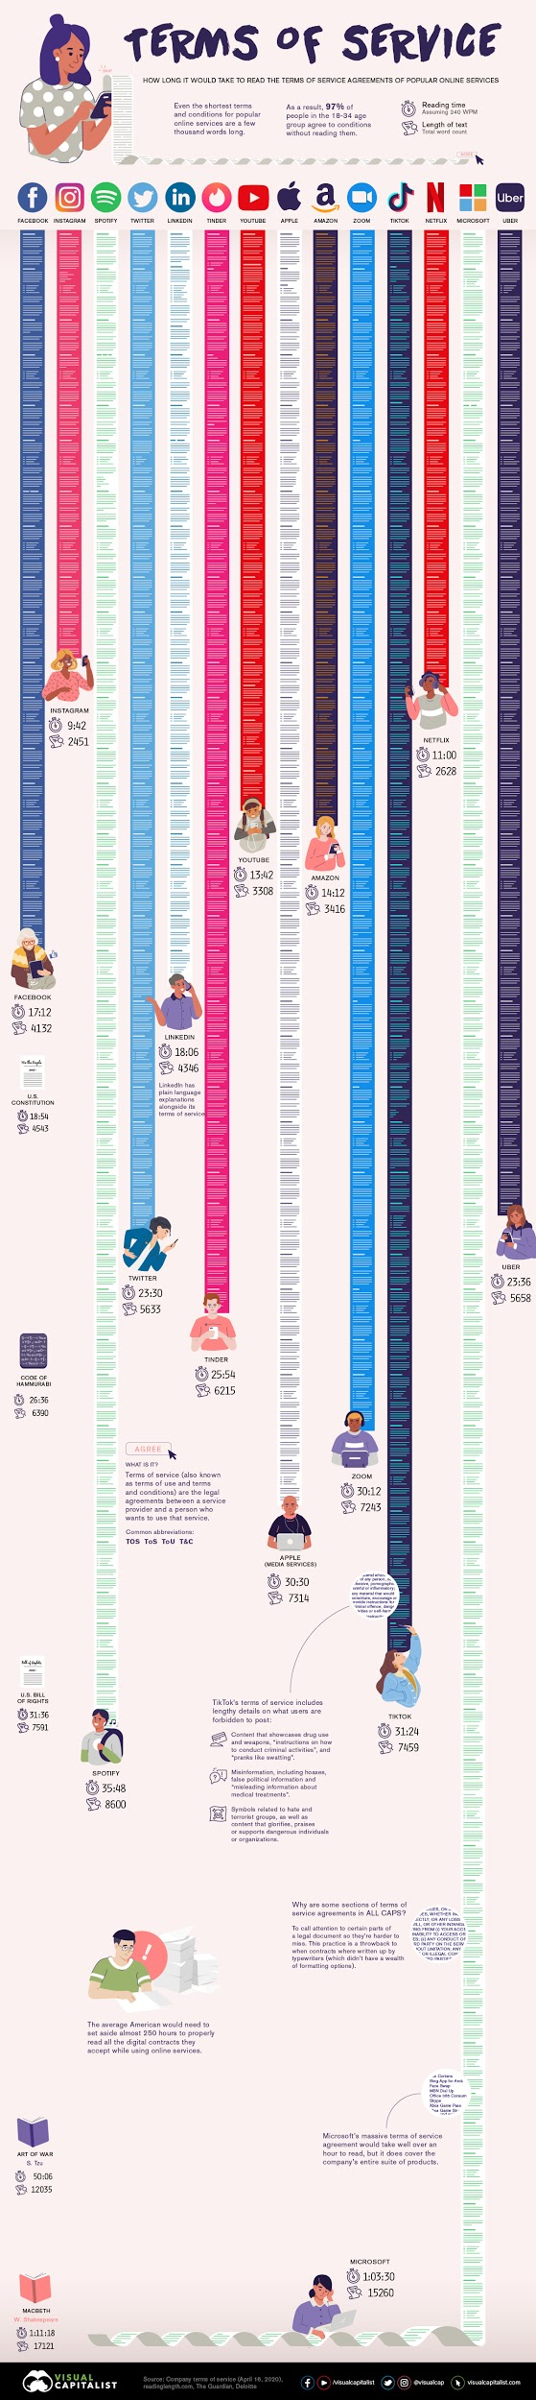
How Long* are Common Terms of Service Agreements?
* Assuming average of 240 WPM
Facebook | Instagram | Spotify | Twitter | LinkedIn | Tinder | YouTube
17:12 | 9:42 | 35:48 | 23:30 | 18:06 | 25:54 | 13:42
Apple | Amazon | Zoom | TikTok | Netflix | Microsoft | Uber
30:30 | 14:12 | 30:12 | 31:24 | 11:00 | 1:03:30 | 23:36
The average American would need to spend 250 hours to properly read all of the agreements they accept for their online activities [2]
https://www.visualcapitalist.com/terms-of-service-visualizing-the-length-of-internet-agreements/

Slide 5
Why is this Important?
Facts:
Legal contracts are binding, even if the user does not read the contract [3]
Drafters are incentivised to include unfair terms [3]
Only 1 percent of users read the ToS [4]
ToS can often be changed at any time without notice to the user [5]
There are very few restrictions on the terms in these agreements [6]
Implications:
Very few people are reading legally binding agreements
These agreements can contain virtually any terms

Slide 6
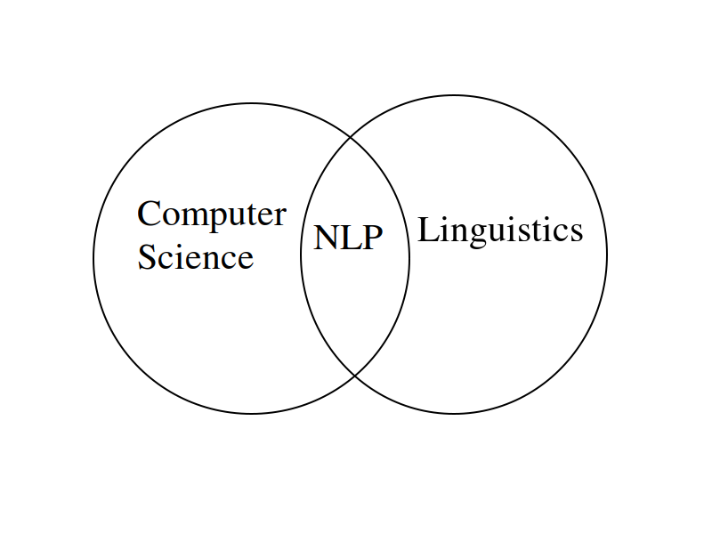
How Can the Problem Benefit from Machine Learning?
There is no feasible way to teach a machine how to understand ToS
However, a machine might be able to learn how to convey the contents to a user using natural language processing (NLP)
NLP is the bridge between computer science and linguistics

Slide 7
Research Hypotheses
A clustering algorithm can be used to identify which known ToS is most similar to an unknown ToS.
A vector similarity measure can be used to compare the similarity of one ToS to another ToS.
A hierarchical clustering algorithm can be used to visually examine the similarity between many ToS.

Slide 8
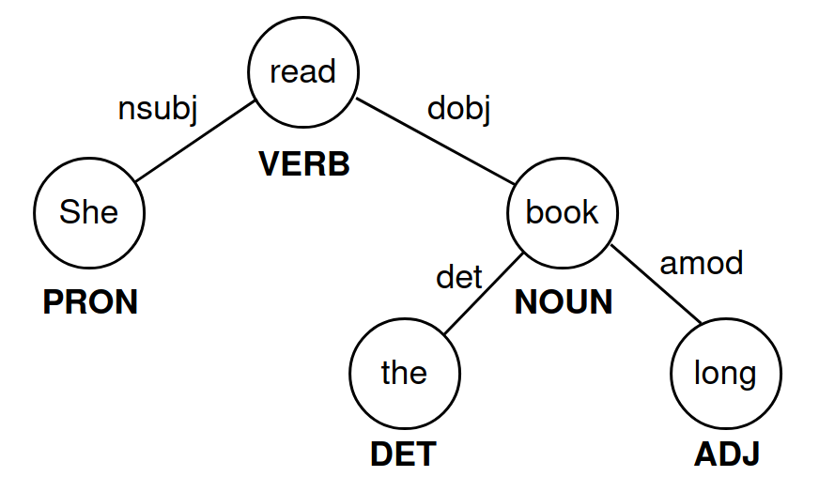
Approach
Use NLP to create feature vectors for every ToS the user is familiar with
Tokenization
Lemmatization
N-grams
Term frequency-inverse document frequency (TF-IDF)
Part of Speech (PoS) tagging
Named Entity recognition
Parse trees
She read the long book.

Slide 9
A clustering algorithm can be used to identify which known ToS is most similar to an unknown ToS.
Plan:
Create TF-IDF feature vectors using many ToS.
Determine which ToS are known to the user.
Create as many clusters as there are ToS using a clustering algorithm.
Use the clustering algorithm to predict which known ToS is most similar to an unknown ToS.

Slide 10
A clustering algorithm can be used to identify which known ToS is most similar to an unknown ToS.
Known ToS: Zoom, Apple Media Services, Microsoft, Twitter, Snapchat, TikTok, Google Terms, Google Privacy Policy, Facebook
Unknown ToS: Pandora
K-Means Prediction on Similarity: Zoom

Slide 11
A vector similarity measure can be used to compare the similarity of one ToS to another ToS.
Plan:
Use the same TF-IDF feature vectors as before.
Determine which ToS are known to the user.
Compare the unknown ToS to all of the known ToS.
Rank the known ToS from most similar to least similar.

Slide 12
A vector similarity measure can be used to compare the similarity of one ToS to another ToS.
ToS | Cosine Similarity (to Pandora) | Euclidean Distance (to Pandora)
Zoom | 0.9729202705615457 | 0.23272184873128812
Apple Media Services | 0.9118911184054235 | 0.41978299535492514
Snapchat | 0.892402975660453 | 0.46389012565379517
Twitter | 0.8774881859662943 | 0.4949986142075663
Microsoft | 0.8469773144514582 | 0.5532136758044607
TikTok | 0.8150336854204963 | 0.6082208720185516
Facebook | 0.48663980566447396 | 1.0132721197541417
Google Terms of Service | 0.378800152777456 | 1.1146298463817879
Google Privacy Policy | 0.2901009383527129 | 1.1915528201865722

Slide 13
A hierarchical clustering algorithm can be used to visually examine the similarity between many ToS.
Plan:
Use the same TF-IDF feature vectors as before.
Use a hierarchical clustering algorithm (Agglomerative Clustering).
Recursively merges the pair of clusters that minimally increases a given linkage distance, using the Euclidean distance [7].
Plot the hierarchical clusters in a dendrogram.
Use this clustering algorithm to compare the similarity of known ToS to an unknown ToS.

Slide 14
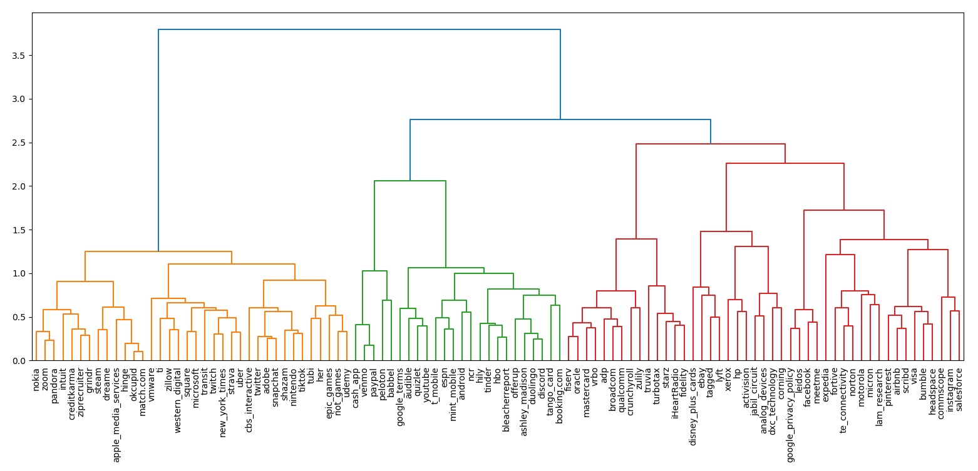
Hierarchical Clustering Output

Slide 15
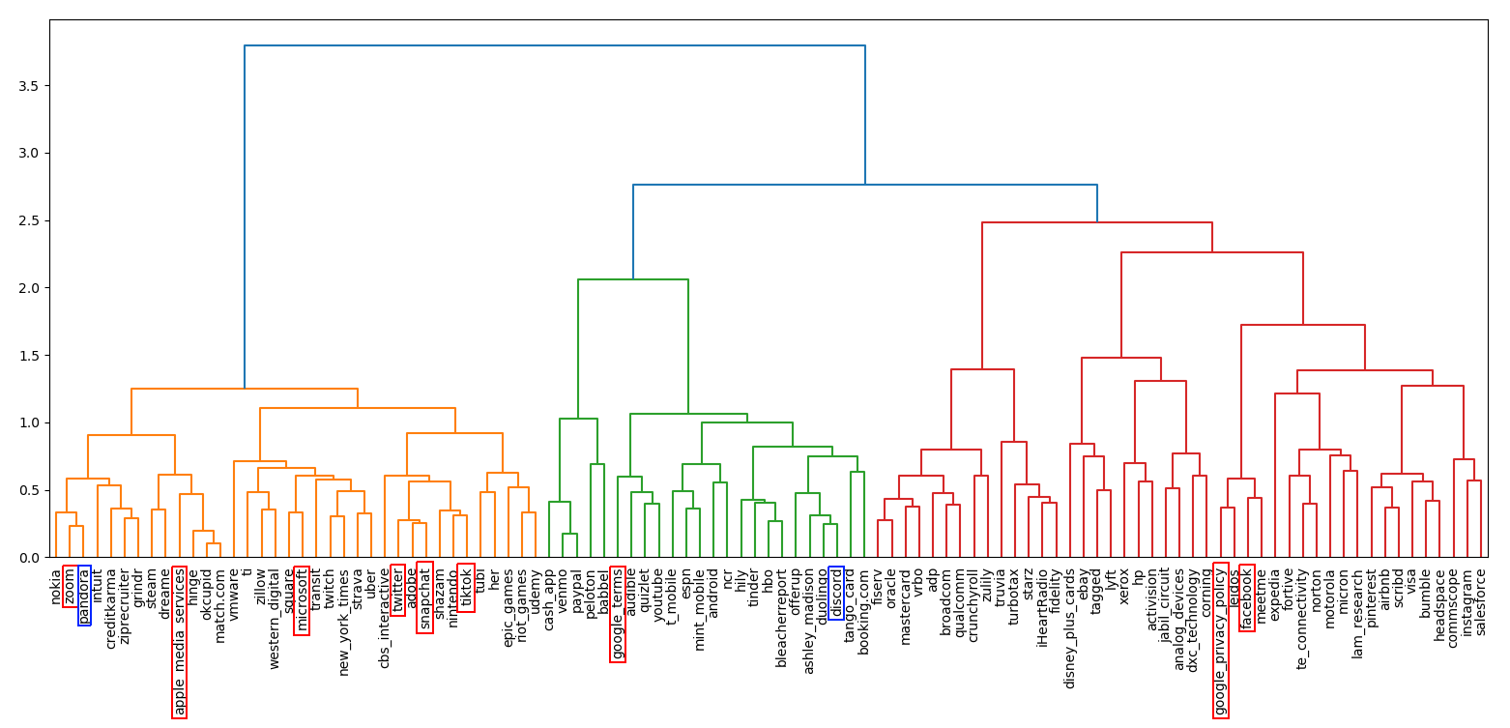
Shaping the Hierarchical Clustering Method to the Hypothesis

Slide 16
Mid-Semester Potential Improvement Ideas
Expand the feature vectors beyond TF-IDF
Be able to create the feature vectors of an unknown ToS without including its word frequency in the total document word frequencies
Didn’t have time to dedicate to debugging required
Find which features affect similarity between two feature vectors the most
Stretch Goal: Allow the user to select which features are most important to them
Time constrained again

Slide 17
Mid-Semester Improvement #1: Expand the feature vectors beyond TF-IDF
I created the framework and expanded the TF-IDF feature vectors to allow other features to be added to the feature vectors. I added:
The normalized number of times the word “data” is mentioned
Whether or not the ToS mentions the phrase (or something like) “We reserve the right to make changes to our site, policies, Service Terms, and these Conditions of Use at any time.”

Slide 18
Mid-Semester Improvement #3: Find which features affect similarity between two feature vectors the most
Cosine similarity and Euclidean distance sum the difference (different for the similarity measures) between the two vectors. This means that the most important feature between two vectors is the one that adds the least to these differences.
Have to leave out the binary values
Most important feature between Zoom and Pandora is “site”
What if “data frequency” was the most important feature?

Slide 19
Works Cited
[1] Goldstein, Jacob, and Alexi Horowitz-Ghazi. “Terms Of Service.” NPR, NPR, 5 Mar. 2020,
www.npr.org/2020/03/04/812264543/episode-976-terms-of-service.
[2] LePan, Nicholas. “Visualizing the Length of the Fine Print, for 14 Popular Apps.” Visual Capitalist, 25 Jan.
2021,
www.visualcapitalist.com/terms-of-service-visualizing-the-length-of-internet-agreements/.
[3] “Can You Be Held Responsible for an Agreement Without Reading It?” New York Business Law RSS,
nylawblog.com/2013/08/can-you-be-held-responsible-for-an-agreement-without-reading-it/.
[4] “Report Finds Only 1 Percent Reads 'Terms & Conditions'.” Digital Journal: A Global Digital Media Network, 29
Jan. 2020,
www.digitaljournal.com/business/report-finds-only-1-percent-reads-terms-conditions/article/566127.
[5] “Frontpage · ToS;DR.” Terms of Service; Didn't Read, tosdr.org/.
[6] ProPrivacy. The Hidden Dangers Lurking Beneath Today’s Surface-Level Data Protection. ProPrivacy.com.
[7] “Sklearn.cluster.AgglomerativeClustering.” Scikit,
scikit-learn.org/stable/modules/generated/sklearn.cluster.AgglomerativeClustering.html.

Slide 20
Questions?

Slide 21
Backup Slides

Slide 22
Data Collection
105 ToS, based upon:
Forbes’ Top 500 Most Valuable Companies
All-time most popular applications on the Google Play app store

Slide 23
Struggles with this Project
Relatively unique problem (I haven’t read much about this)
Didn’t have a clear process for solving the problem in my head
Plan #1: Clustering for all data
Plan #2: Distance measures for known ToS

Slide 24
Detailed Implementations (Clustering)
Gather a lot of ToS (final result was 105 unique ToS)
Perform unsupervised clustering with an ideal number of clusters
How to find this ideal number of clusters?
Use clustering indices to indicate which number of clusters was ideal
Use the trained clusters to determine which known ToS is most similar to a novel ToS

Slide 25
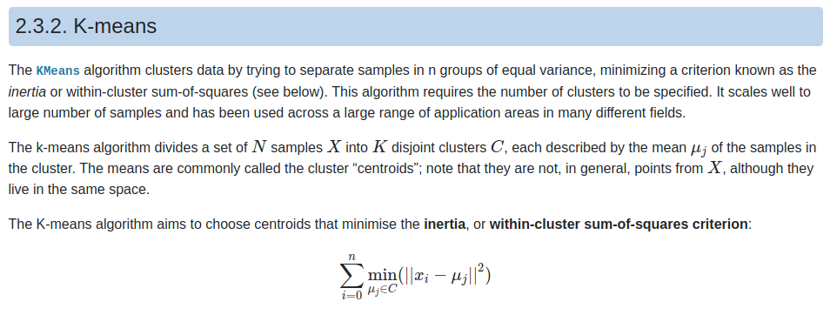
Mathematical Understanding (Clustering)
K-means - divides a set of N samples into K (hyperparameter) disjoint clusters, each described by the average vector of the samples in the cluster. Minimizes the within-cluster sum-of-squares
https://scikit-learn.org/stable/modules/clustering.html#k-means

Slide 26
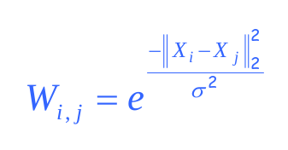
Mathematical Understanding (Clustering)
Spectral Clustering - performs a low-dimension embedding of the affinity matrix between samples, followed by another clustering algorithm (K-Means)
Affinity matrix formulation:
https://www.google.com/url?sa=t&rct=j&q=&esrc=s&source=web&cd=&ved=2ahUKEwiB9r3a3N_vAhWWQjABHd11AFcQFjACegQIAxAD&url=https%3A%2F%2Fwww.cs.cmu.edu%2F~epxing%2FClass%2F10701-08s%2FLecture%2Flecture23-Spectral.pdf&usg=AOvVaw06QejPAqYUlAxAes6SVFlt
https://scikit-learn.org/stable/modules/clustering.html#spectral-clustering

Slide 27
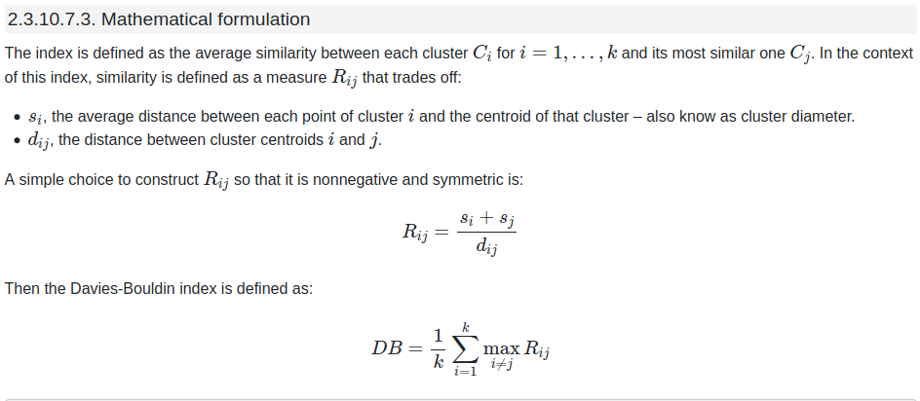
Mathematical Understanding (Clustering)
Davies-Bouldin Index - signifies average ‘similarity’ between clusters. The similarity is based on comparing the distance between clusters with the size of the clusters themselves. Zero is the best score.
https://scikit-learn.org/stable/modules/clustering.html#davies-bouldin-index

Slide 28
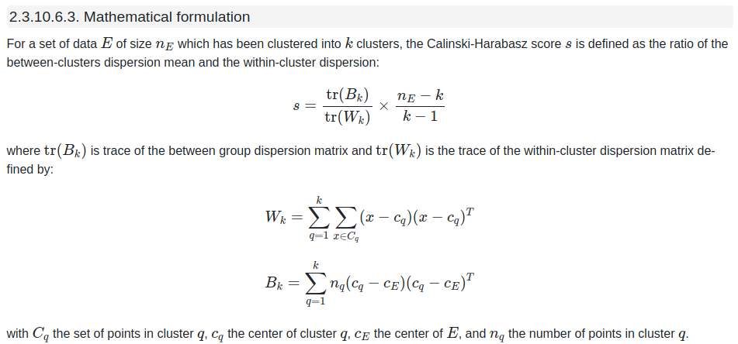
Mathematical Understanding (Clustering)
Calinski-Harabasz Index - ratio of the sum of between-clusters dispersion and within-cluster dispersion. Score is higher when well separated.
https://scikit-learn.org/stable/modules/clustering.html#calinski-harabasz-index

Slide 29
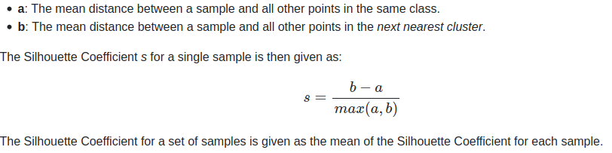
Mathematical Understanding (Clustering)
Silhouette Coefficient - compares the density of a cluster with the proximity of the next nearest cluster. +1 is the best score, -1 is the worst score.
https://scikit-learn.org/stable/modules/clustering.html#silhouette-coefficient

Slide 30
Detailed Implementation (Similarities)
Focused around the problem
Collect a lot of ToS. Use these to define the normal frequency of words in a ToS
Find the known ToS and the new ToS
Create the vectors (just TF-IDF for now)
Use similarity measures to determine which known ToS is most similar to the new ToS
In progress: using clustering algorithms to find which known ToS is most similar to the new ToS

Slide 31
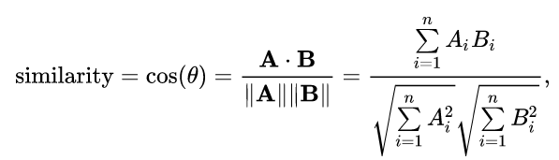
Mathematical Understanding (Similarities)
Using most of the same unsupervised clustering clustering algorithms and similarity indices:
K-Means
Spectral Clustering
Davies-Bouldin Index
Calinski-Harabasz Index
Silhouette Coefficient
New:
Cosine Similarity
https://en.wikipedia.org/wiki/Cosine_similarity

Slide 32
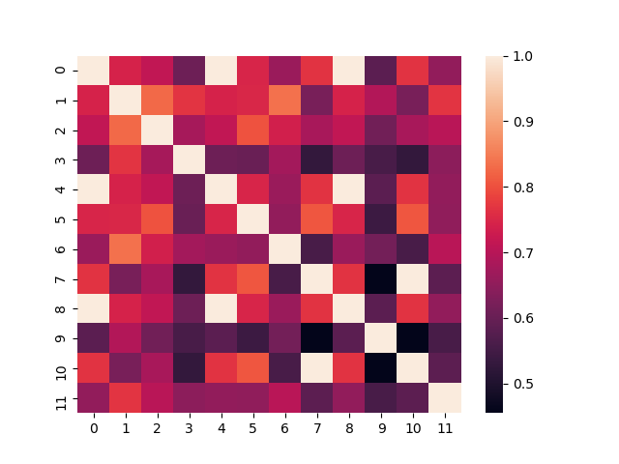
Original TF-IDF Heatmap
facebook_terms_and_data_policy : 0
tiktok_terms : 3
youtube_terms : 4
apple_media_services_terms : 3
facebook_with_sections : 0
google_terms : 2
twitter_terms : 1
google_with_table_contents : 2
facebook_with_table_contents : 0
instagram_terms : 1
google_privacy_policy : 2
microsoft_terms : 1

